Slide 1

Medical Report Generation
Prof .Dr. Abeer Mahmoud
TA. Yomna Ahmed
Members:
Nada Mohamed Mohamed Hassan
Hadeel Osama Abdullah Abbar
Nouran Sayed Nasr Ibrahim
Manar Mahmoud Ahmed
Hagar Ahmed Mahmoud

Slide 2


INTRODUCTION
Medical imaging plays a significant role in the diagnosis and treatment of diseases.
Computer-aided diagnosis and medical imaging systems have improved in the past decade to a point where they can partially mimic radiologists.
The most common medical imaging application is the Chest X-Ray.

Slide 3
MOTIVATION
Building intelligence system that use recent deep learning model to generate reports.
Helps reduce workload of radiologists in writing medical reports.
We intend to effectively capture abnormal regions to describe normal and abnormal diagnoses.

Slide 4
OBJECTIVE
Create an application that helps physicians to generate reports from medical images.
Insert chest x-ray as an input to the application, then generate a report automatically.
We will achieve this Objectives by the following steps:
Survey
Select most recent and accurate techniques.
Implement our proposed model.
Test model.
Compare our result with survey.
Modification

Slide 5
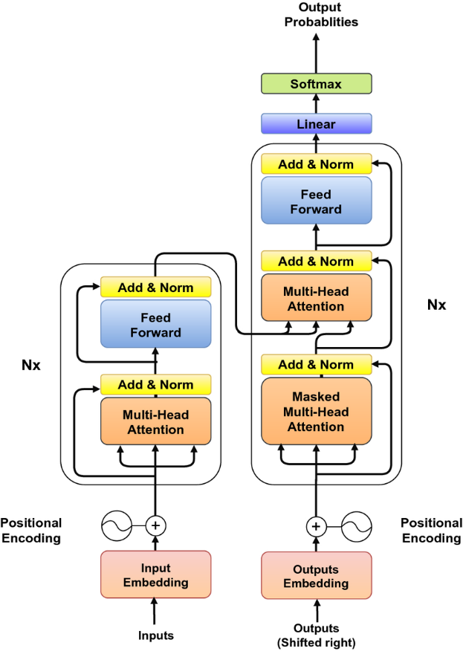

Transformer
Encoder-Decoder based on attention.

Slide 6
The model Structure
Visual Extractor.
Standard Encoder from transformer.
Decoder from transformer with extra relational memory module and MCLN.

Slide 7
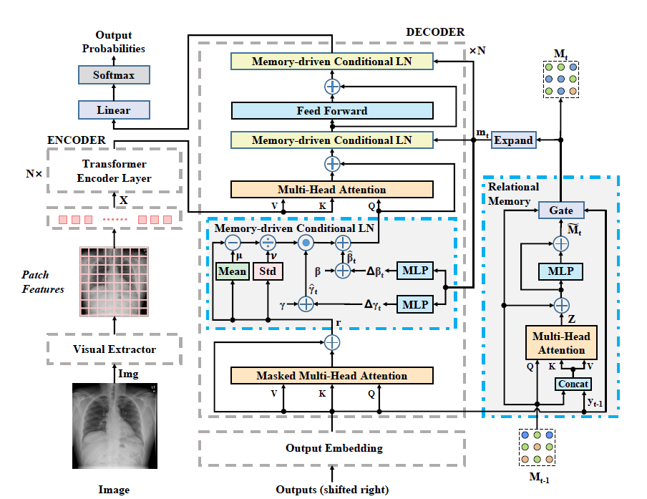
System Architecture

Slide 8
Explanation of finished phases
Train:-
Model trained on 5,226 images , 2,770 report with 100 epoch and batch size =16 take
Image + report as input
Tokenize report and Load data (iu_xray) with 7,470 chest X-ray images and 3,955 reports
Build model(R2Gen ):-
Visual Extractor using pretrained model resnet 101
transformer:- Encoder, Decoder
Relational memory
Memory-driven Conditional Layer Normalization (MCLN)
The model is trained under cross entropy loss with ADAM optimizer

Slide 9
Explanation of finished phases
Test:-
Test with 1,496 Images, 790 report images with 100 epoch and batch size 16.
create tokenizer and create data loader.
build model architecture.
handles of loss and metrics then build tester.

Slide 10
Explanation of finished phases
Deployment:-
Deploy model on website using Flask:
upload 2 images on website then report generated.

Slide 11
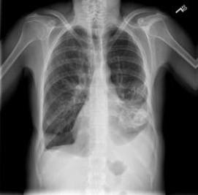
Dataset
IU-X-ray:
Public dataset contains 3,955 radiology reports and 7,470 X-rays images.
Partitioned into train, validation, test set by 70% , 10% , 20%.
Report:
The heart is within normal limits in size. Surgical suture material projects over the right lung apex. The lungs are hyperlucent and hyperinflated compatible with emphysema. There is left lower lobe airspace disease identified. There is moderate left pleural effusion and small right pleural effusion. No visualized pneumothorax.

Slide 12
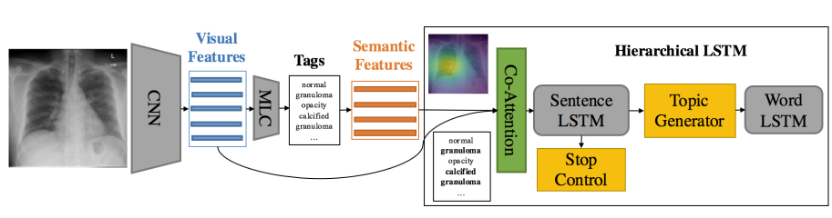
Other trials:
We try another Machine learning Model(Co-Attention)
Image will pass in CNN then extract features and act as input to Tags After Semantic features as input to ” Co-Attention – Sentence LSTM – Word LSTM ”

Slide 13
Experiments and Results
Model | Training accuracy | Testing accuracy | No. of images | Testing time for one image
R2Gen | BL-1: | BL-1: | Training: 5,226 images | 12 sec
 |  |  | Testing: 1,496 Images
CoAtt | BL-1:0.795 | BL-1:0.025 | Training: 5,184
 |  |  | Testing: 1,296

Slide 14
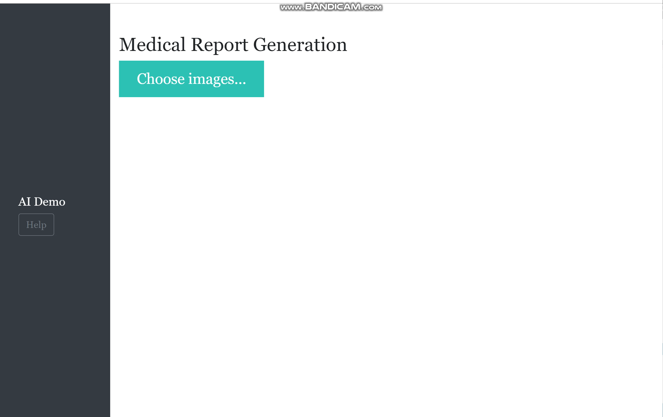
Demo

Slide 15
What’s Next?
Make website have two users:
Doctor: upload image and take report.
Patient: upload report to understand any unclear word.

Slide 16


THANK YOU

